Slide 1
Collaborative Conversations:
The Wealth Gap:
What can We Do Today?
By: Toby Way, Kaitlyn Seeto, and Megan Staples
Notes:
Why the Wealth Gap
And What Can/Should Be Done?

Slide 2
GASP
STOMP
CLAP
During the first quarter of 2021, New York City had a $2,152 dollar per square foot price for land on average. What was the mean dollar per square foot of NYC back in 1999?
You bought $1000 in stock in IBM 1972. How much is that stock worth today?
Educated Guesses
As of March 2022, a gallon of milk in America costs $4.04. What would be the cost of it in 1920?
$202,537
$13,851
$145,247
¢35
¢5
¢55
$47
$500
$1026

Slide 3
Guiding Question
Are there historical reasons for present-day differences in wealth of different groups?

Slide 4
Table Rules
Listening is as important as talking. Listen, even when you disagree.
Try to achieve common grounding within the discussion by acknowledging, clarifying, and contributing
Be respectful of each other
Disagree with other group’s reasonings, not the people
Take turns sharing out!

Slide 5
Dialogue Roadmap
Review the Graph and Video
[Manhattan Beach]
Share Out
Share out your model with the class.
Round 2 Introduce Data
1
3
5
2
4
6
Round 1 Conversation
Exploring Differences in Wealth
Each person shares out their thoughts for about 1 min.
Task: Modeling Reparation for the Bruce’s Family
Extended Round:
Open Discussion

Slide 6
Round 1
Video of Bruce’s Beach and Wealth Graph
Think about “What Intrigued you?” and “What did you wonder?”
Each person shares their thoughts (~1 min) uninterrupted.
Notes:
Add a slide with an excerpt from both of the articles so that participants can have access to the main ideas
Additional Resources:
Youtube Video about Bruce’s Beach: https://youtu.be/dbERFYZVaeI
“Manhattan Beach was once home to Black beachgoers, but the city ran them out. Now it faces a reckoning” By Rosanna Xia
“Why we need reparations for Black Americans” By Rashawn Ray and Andre M. Perry

Slide 7
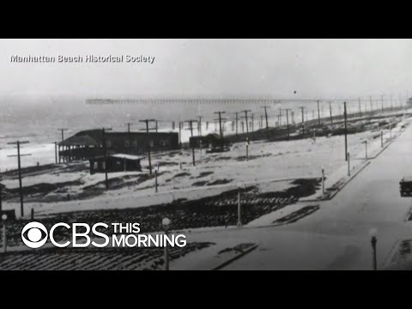
Notice and Wonder
CBS This Morning
April 9, 2021
“LA County may return beachfront property that was seized from a Black family nearly a century ago”
Notes:
https://youtu.be/dbERFYZVaeI
From CBS This Morning

Slide 8
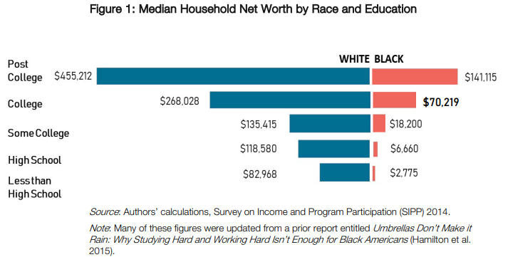
Notice and Wonder
Net worth=
Assets - Liabilities
Networth is the total value of all your assets (cash, investments, car, house) minus your liabilities credit card debt, loans, mortgage).
Notes:
Calculator
https://www.ramseysolutions.com/retirement/net-worth-calculator

Slide 9
Round 1: Reactions
Recall guiding question:
Are there historical reasons to our present-day differences in wealth by race?
What are your initial thoughts?
What intrigued you? What do you wonder?
Each person shares their thoughts (up to ~1 min) uninterrupted.

Slide 10
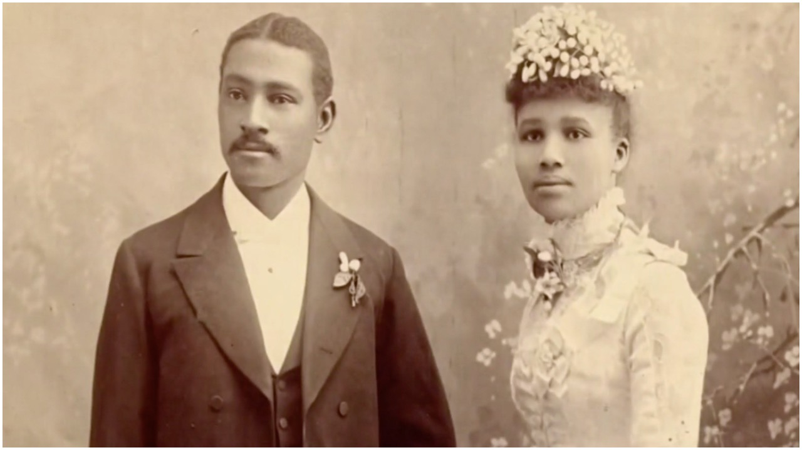
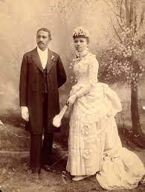
Round 2
Exploring the Case of the Bruces and Bruce’s Beach
The impact of the loss of generational wealth is difficult to calculate, but [Bruce-descendant] Shepard said the majority of Bruces today live under the poverty line … “It’s hit them very hard – there are student loans they could have paid off, there are mortgages they might not even have had. They would have been multimillionaires.” (The Guardian, April 17, 2021)
Notes:
IDEA: use smaller problem to help you solve a larger one, or help you think about what to pay attention to.

Slide 11
Round 2
Overarching Question:
What was the economic impact on the Bruce family as a result of the land seizure and corresponding business closure?
Notes:
Edit (3/29): Put the reading here and talk about why we need reparations
IDEA: use smaller problem to help you solve a larger one, or help you think about what to pay attention to.

Slide 12
Brainstorm
Mr. Madura has a side hustle - Madura’s Mansions
Mr. Madura runs it through Airbnb.
He has 2 places to rent. Both properties are on the beach.
What is the business worth today?
What will the business be worth in 10 years?
How do we determine the value of the business TODAY and in 𝒙 years?

Slide 13
Modeling the Economic Impact
on the Bruce Family
Time to tackle this challenge: let’s determine the loss of generational wealth for the Bruce Family. We’ll each take a piece to get some reasonable estimate of the economic impact on the Bruce family
Take 1 aspect of the economic impact --
lost income
lost land/property
lost opportunities for expansion
other opportunities
Find a way to estimate the values and the present-day value that could have been part of the Bruce’s family wealth.
Notes:
(Note: the value of the land is provided by current day news outlets. Est ~$70million)

Slide 14
TASK : Modeling Economic Impact
The Bruce Family
Use data and your smarts to create a model to estimate the economic impact of the Bruce Family with your small group on the worksheet. This is only a first draft!!
Come up with a defensible amount of money that you would give in reparations to the Bruce family.

Slide 15
lost opportunity to invest profits in other areas
Pick Your Focus
lost opportunity for improvements to expand business
loss of income/profits
loss of property
Notes:
https://docs.google.com/document/d/1V7Fm8yPX3i3GQcrNqU1YyfNewAhQwXUSfsnZCb853_g/edit#

Slide 16
Generate First-Draft
estimate information
ballpark a value
use any tools (spreadsheets, calculators, etc.)
Justify your work

Slide 17
Share Out
Questions to answer: (One Spokesperson)
What aspect of economic impact did you try to model?
What information did you use to create your model?
What uncertainty do you have in your model?
What was the value you came up with?
What would be your next steps to refine your model?

Slide 18
DATA: Important Terms
Income: the amount of money that a person earns
Household Income: the amount of money that everyone within a household (one address) earns
Wealth (also referred to as net worth): wealth represents what a person owns in terms of all physical (lands, cars, etc.) and intangible (patents, trademarks, etc.) assets owned. This does not include financial assets (stocks, bonds, etc.)
Difference between income and wealth: Income is not always a part of someone’s wealth. Depending on how someone uses their income, this does not always contribute to their wealth.
Notes:
Compare to the data that we are giving the class

Slide 19
Est. total economic impact on the Bruce Family

Slide 20
Reflection
What was the impact on the Bruce family? What should be done?
What are some historical factors that might have contributed to the Bruces’ situation?
What does it mean for the present day wealth gap?
Notes:
Edit (3/29): Put the reading here and talk about why we need reparations
IDEA: use smaller problem to help you solve a larger one, or help you think about what to pay attention to.

Slide 21
Notice and Wonder
Are there historical reasons for present-day differences in wealth of different groups?
Notes:
Calculator
https://www.ramseysolutions.com/retirement/net-worth-calculator

Slide 22
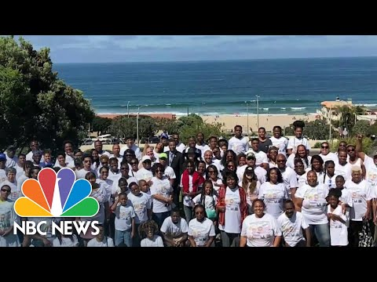
Conclusion of Bruce’s Beach
(Manhattan Beach)
"Well, what do you think generational wealth could have looked like for the Bruces?" Brandford notes. "Let's look at the Gettys. Let's look at the Rockefellers. Let's look at the Fords. Let's look at the Bushes. Let's look at the Kennedys. That's what generational wealth could look like for the Bruce family."
CA Bill -release posted Oct 4, 2021
Start to 0:15
2:29 - 3:51
NBC News
Oct 1, 2021
Notes:
https://youtu.be/Lj_1HNNtv1w

Slide 23
The Modeling Process
Real-World
Problem
Modeling
NO, more could be done.
Reparation proposal
Put it back in context:
Does it work?
YES, it works!
Reflect on the math and math process
Notes:
There is no such thing as a correct value - open ended model

Slide 24
Resources:
Articles:
“How I Can Offer Reparations in Direct Proportion to My White Privilege” By Chris Moore-Backman
“What America owes: How reparations would look and who would pay” By Samara Lynn and Catherine Thorbecke
“How Could the United States Pay for Reparations?” By Janet Holtzblatt and Noah Zwiefel

Slide 25
Thanks!
Any questions?
toby.way@uconn.edu
kaitlyn.seeto@uconn.edu
Exit Ticket

