Slide 1
ECS Formula
(Education Cost Sharing)
Funding Distribution
By: Toby Way
& Kaitlyn Seeto
University of Connecticut
Notes:
This work was funded in part by a Dean’s Research Incentive grant and a Democratic Dialogues Initiative fellowship, both at the University of Connecticut.
Materials are protected by Creative Commons copyright. Materials were developed 2021 based on the most current information available.

Slide 2
How do schools get funded? Where does the money come from?

Slide 3
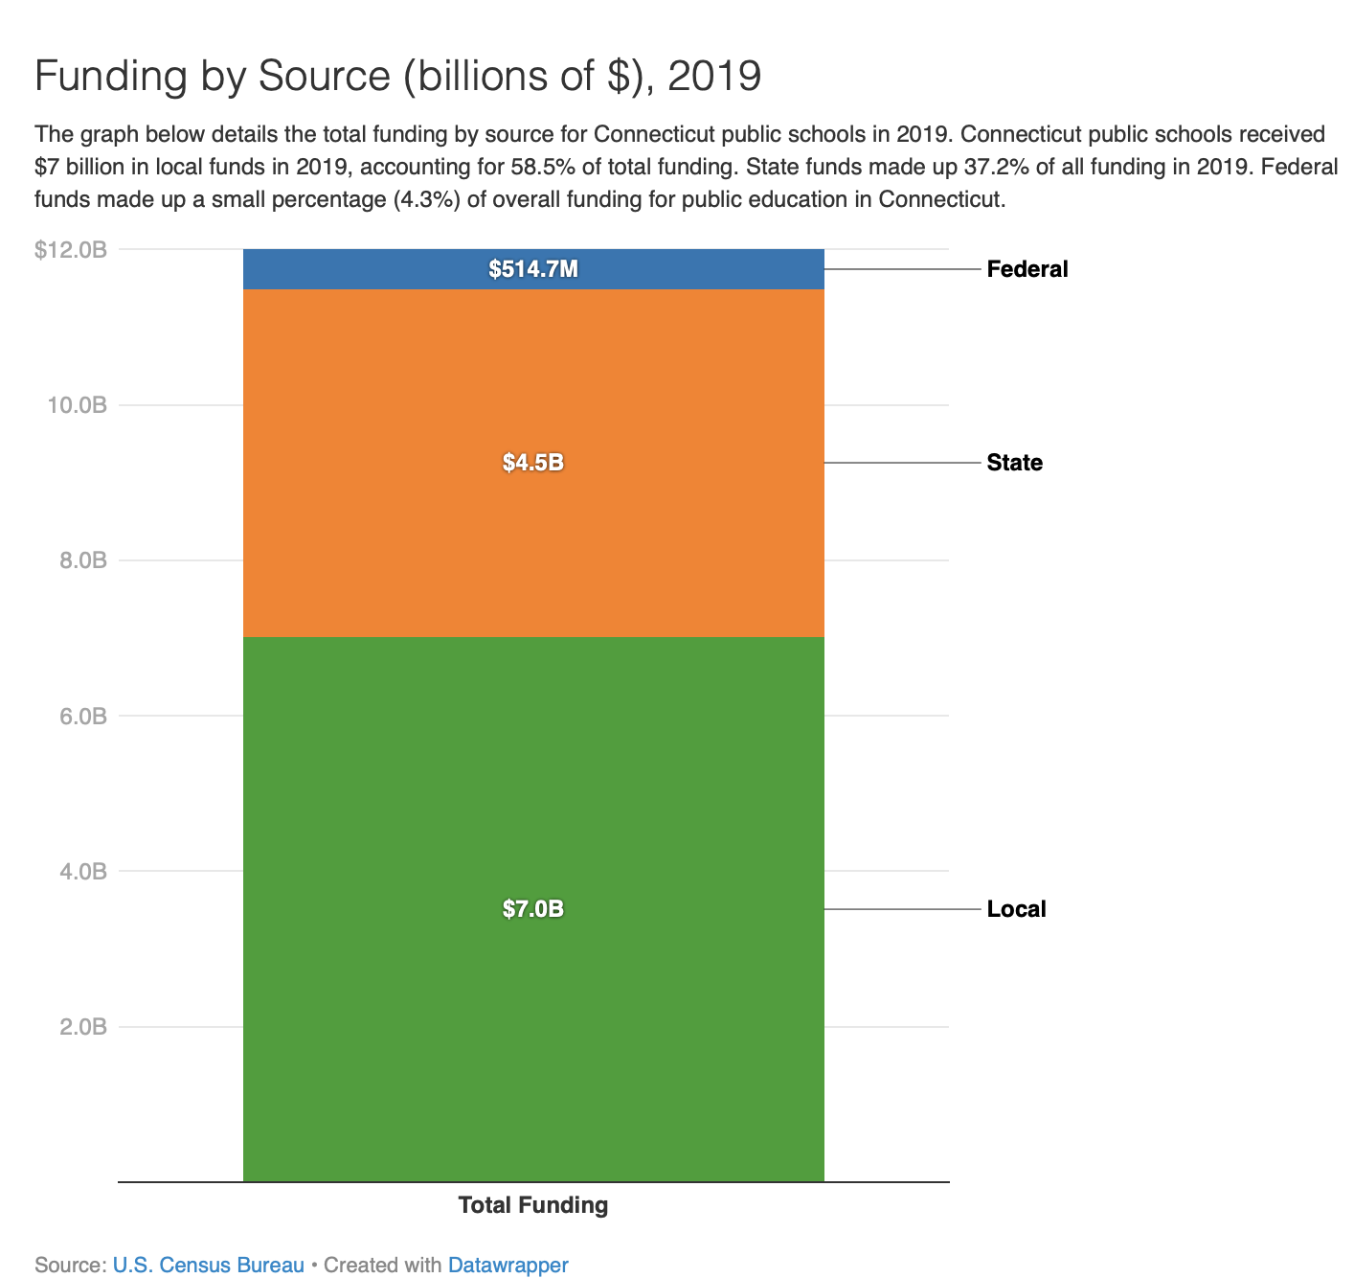
$515 Million
$4.5 Billion
$7.0 Billion
Notes:
https://ctschoolfinance.org/issues/how-ct-funds-education retrieved December, 2021

Slide 4

What factors would you consider when distributing money to different school districts?
What Would You Do?
Brainstorm
Write at least 3 things you think should be considered.

Slide 5
Share Out Factors You Think Should be Considered

Slide 6
ECS Formula
The Education Cost Sharing (ECS) formula is the method the State of Connecticut has established to distribute approximately $2 billion annually in state education funding.

Slide 7


Activity! SPLIT THE PIE
Overarching questions:
How would you distribute the money?
What would be Fair?
Notes:
Seed idea:
Use of math:
We select the criteria and then see the consequence of that. We are making choices by mathematizing things.

Slide 8
Split The Pie
Each table gets information on cards about a district
(4 different districts)
Using information for your district, information about the state averages, and the factors you think should be considered, you will try to answer:
What funding should your school district get?

Slide 9

Split the Pie: A few more notes
For the 4 districts, the total from the state is 82 million!
it is not a requirement to use all the cards.
Table Rules:
Be respectful of each other
Disagree with other group’s reasons, not the people
Justify your use of the cards
Take turns Presenting your Case!
84 Million is the real total that these 4 districts receive!
Notes:
Prompt people to do more math and calculations

Slide 10
SPLIT THE PIE
What would be fair??
CARDS
# Students | # Low Income Students | # English learners | Median Household income | # Teachers in District
% Minority enrollment | % Students with health disability | # of Schools in the district | % Families below poverty line | % Parents/ Guardians not in Labor Force
Your cards have:
One District’s data for those Factors
the State Values for Each of those Factors
Notes:
Emphasis on the 79 million dollars - this is the actual amount that is distributed between the 3 schools

Slide 11
SPLIT THE PIE
What Funding Should Your District Get?
Create a budget proposal for your district using the data on your cards.
The budget is 82 million dollars for educational fundings to all four districts.
Think about the factors that were mentioned earlier.
Notes:
Emphasis on the 79 million dollars - this is the actual amount that is distributed between the 3 schools

Slide 12
Work Time
Share out

Slide 13
ECS Formula
Time for a look at what CT actually does!
The Education Cost Sharing (ECS) formula is the method the State of Connecticut has established to distribute approximately $2 billion annually in state education funding.

Slide 14
ECS Formula
There are 3 main parts.
Foundation
Student Need Weights
Base Aid Ratio
Keep pondering… Is it fair?

Slide 15
Foundation
The foundation in the ECS formula is $11,525 per student.
the foundation amount is the estimated cost of educating a general education student who does NOT have any additional learning needs.
This number has been in place ever since the 2017 reform of the ECS formula. The previous foundation amount for each student in Connecticut was $9,687 from 2007 to 2017.

Slide 16

Student Need Weights
Low Income Student Weight
For students eligible for free or reduced-price lunch, the foundation amount increases by 30%.
Concentrated Poverty Student Weight
If the district has 60% or more students who are considered economically disadvantaged, the foundation amount for each student over the 60% threshold increases by 15%.
English Learner Weight
For students that need additional English-language skills, the foundation amount increases by 25%.

Slide 17
Student Need Weights Calculation
1580 +
(0.3 * 464) +
(0.15 * 1580*(464/1580 - 60%))
+ (0.25 * 49)
District A:
1731
Need Student Count
Total students
+
(0.3 * FRPL students)
+
(0.15 * #Low-Income Students over 60%)
+
(0.25 * ELL students)
8027 +
(0.3 * 5050) +
(0.15 * 8027*(5050/8027 - 60%))
+ (0.25 * 1076)
District B:
9846
8588 +
(0.3 * 1891) +
(0.15 * 8588*(1891/8588 - 60%))
+ (0.25 * 353)
District C:
9244
1551 +
(0.3 * 577) +
(0.15 * 1551*(577/1551 - 60%))
+ (0.25 * 108)
District D:
1751

Slide 18
Base Aid Ratio
Determines how much the state provides of what is ‘needed’, based on how much funding the district(s) has to support themselves.
Towns that have less money to fund their schools receive the most state aid.
Property Wealth Factor
(70% of Base Aid)
What can/should businesses in town contribute?
Income Wealth Factor
(30% of Base Aid)
What can/should people in the town contribute?

Slide 19
Base Aid Ratio
Property Wealth Factor (70% of Base Aid)
0.7 * [1 – (town’s equalized net grand list per capita (ENGLPC)/ 1.35 * median equalized net grand list per capita among CT towns)]
Income Wealth Factor (30% of Base Aid)
0.3 * [1 – (town’s median household income / (1.35 * median household income among CT towns))]
Addition for the 19 towns with a Public Investment Community index (a measurement of wealth) value above 300 (i.e., for the least-wealthy towns): Add 6 percentage points for highest five towns, 5 points for next five towns, 4 points for next five, and 3 for remaining four
+
+

Slide 20
New Thoughts on what your District might get for Funding?
Guess the District?
A, B, C, D

Slide 21

 | 9 million | 69 million | 1 Million | 3 Million
Resident Student Count | 1580 | 8027 | 8588 | 1551
Low Income Student Count | 464 | 5050 | 1891 | 577
English Language Learners Count | 49 | 1076 | 353 | 108
Median Household Income | $56,807 | $55,468 | $142,819 | $76,360
Number of Teachers in District | 108 | 522 | 789 | 159
Minority Enrollment | 31% | 85% | 38% | 19%
Here is the funding each district received for 2022 Fiscal year

Slide 22
 | Mansfield 9 million | East Hartford 69 million | Greenwich 1 Million | Clinton 3 Million
Resident Student Count | 1580 | 8027 | 8588 | 1551
Low Income Student Count | 464 | 5050 | 1891 | 577
English Language Learners Count | 49 | 1076 | 353 | 108
Median Household Income | $56,807 | $55,468 | $142,819 | $76,360
Number of Teachers in District | 108 | 522 | 789 | 159
Minority Enrollment | 31% | 85% | 38% | 19%
Here is the funding each district received for 2022 Fiscal year

Slide 23
DISCUSSION
Foundation
Student Need Weights
Base Aid Ratio
What do you think about each component?
Are they “fair”? What is “fair”?

Slide 24
ECS formula for Mansfield.
$11,525
X
1,731
X
44.45%
= $ 8,869,950
Foundation
X
Need Student Count
Total students +
(0.3 * FRPL students) +
(0.15 * #Low-Income Students over 60%)
+ (0.25 * ELL students)
X
Base Aid Ratio
Determining how much of the needed $ the state government should provide outside of district self-funding.
=
Initial Grant
*Not including Regional School District Bonus

Slide 25
ECS formula for East Hartford.
$11,525
X
9,846
X
61.23%
= $ 69,473,812
Foundation
X
Need Student Count
Total students +
(0.3 * FRPL students) +
(0.15 * #Low-Income Students over 60%)
+ (0.25 * ELL students)
X
Base Aid Ratio
Determining how much of the needed $ the state government should provide outside of district self-funding.
=
Initial Grant
*Not including Regional School District Bonus

Slide 26
ECS formula for Greenwich.
$11,525
X
9,244
X
1.00%
= $ 1,065,326
Foundation
X
Need Student Count
Total students +
(0.3 * FRPL students) +
(0.15 * #Low-Income Students over 60%)
+ (0.25 * ELL students)
X
Base Aid Ratio
Determining how much of the needed $ the state government should provide outside of district self-funding.
=
Initial Grant
*Not including Regional School District Bonus

Slide 27
ECS formula for Clinton.
$11,525
X
1,751
X
15.94%
= $ 3,218,000
Foundation
X
Need Student Count
Total students +
(0.3 * FRPL students) +
(0.15 * #Low-Income Students over 60%)
+ (0.25 * ELL students)
X
Base Aid Ratio
Determining how much of the needed $ the state government should provide outside of district self-funding.
=
Initial Grant
*Not including Regional School District Bonus

Slide 28
Reflection
How did you use math in this lesson?
What are the consequences of this formula for you? For others in CT?

Slide 29
Exit Ticket

Slide 30



Extra Resources
ECS Formula Gov. website
(old) ECS Formula Break down
CAPSS Website
(ECS Change Proposals)
ECS 2022 DATA Exploration

Slide 31
Thanks!
Any questions?

