Slide 1
Collaborative Conversations:
Vaccines
By: Kaitlyn Seeto, Megan Staples & Toby Way, UConn

Slide 2
PURPOSES
Bigger picture….
We want to think more about the role mathematics plays in democratic participation.
What kind of mathematics and ways of reasoning with mathematics are helpful for citizens as they consider public issues?
How does knowing the math/using the math provide new perspectives that perhaps aren’t accessible through description or non-quantitative means?
Today: Using a protocol (Collaborative Conversations) developed to support deliberative discussions about public issues and give people more practice in having discussions that bring in multiple viewpoints.

Slide 3



Collaborative Conversations
Based on
Encounters: A Forum for Public Discussion
A program of the Initiative on Campus Dialogues
at the University of Connecticut-Storrs
Sponsored by the UConn Humanities Institute
and the Humility & Conviction in Public Life Project
Adapted for high schools as the pilot Collaborative Conversations
by the CT State Department of Education &
The Connecticut Democracy Center at Connecticut’s Old State House
Further adapted to focus on the mathematics of democratic participation.
Notes:
https://uconn-cmr.webex.com/join/mes05011

Slide 4
MAIN FEATURES of Collaborative Conversations
Provide opportunities to learn and practice conversation skills in a friendly environment
Don’t focus on “winning” or trying to convince others. It’s not a debate. It’s about exploration and understanding.
Our use of CC aims to explore how mathematics IS used and/or CAN BE used when engaging various topics relevant to public life/citizenship.
Notes:
Rather than telling people how to have a good, polite, respectful conversation, Collaborative Conversations provide opportunities to learn and practice conversation skills in a friendly environment.
The model isn’t focused on “winning” or trying to convince others. It’s not a debate. It’s about exploration and understanding. This program is about encountering people who may have different opinions.
This approach acknowledges that it’s fine to come to a conversation with convictions -- but they should be tempered by humility.
Our particular use of the model aims to explore how mathematics is used and/or can be used when engaging various topics relevant to public life/citizenship.

Slide 5
INTRODUCTIONS of ROLES
Participants
Moderator: review table rules, guide everyone through the program using slides and act as timekeeper
Table facilitators: one person in each group will ensure that table rules and time limits are followed.
Expert: Can join in discussion at a table, or move from table to table during the conversations. They will answer collaborative questions near the end of the program.

Slide 6
Collaborative Conversation: ROUNDS
1A
2A
READINGS
READINGS
1B
2B
SHARING THOUGHTS
OPEN CONVERSATION
Review articles
Explore how the vaccination data are being analyzed
Everyone takes a turn in answering a question in context of the readings.
Participants can share out their questions and/or opinions, and respond to one another.

Slide 7
ROUNDS
3
FORMING COLLABORATIVE QUESTIONS
4
OPEN FORUM
5
TAKEAWAYS
Each group works together to create collaborative questions to ask the expert(s).
One group member from each table shares their group’s question and the expert(s) will respond to them collectively.
Individuals reflect on their takeaways. What did we learn about conversations? About the topic we discussed? About ourselves?

Slide 8
ROUND
Review the article(s) briefly.
Look at the question and reflect.
Each person shares their thoughts (1 min) uninterrupted.
Articles:
“Notes from the Field: Measles Outbreak --- Indiana, June--July 2011”
“Measles and the modern history of vaccination”
1

Slide 9
TABLE RULES
Be honest
Listen, even when you disagree
Use “I statements”
This is not a debate. Allow open and honest engagement.
  DON’T try to change the other person’s opinion
  DO try to achieve common grounding (acknowledge, clarify, contribute)
Critique the idea, not the person. Conversations are about substance
Be adhere of time limit
Other ideas?

Slide 10
ROUND
Discussion: Each person shares their thoughts (1 min) uninterrupted.
1
What should the role of State Departments of Health and/or CDC* be in managing infectious diseases?
* Centers of Disease Control
Notes:
Information, education, regulation
>> What FACTORS should State Dept of Health

Slide 11
ROUND
“Measles and the modern history of vaccination” (excerpts)
With measles, there was a movement in the public health administration towards requiring this vaccine for children entering public schools and making the vaccine accessible to everyone in an effort to eradicating the disease from society.
1
Articles
“Notes from the Field: Measles Outbreak - Indiana, June - July 2011”

Slide 12
ROUND
Discussion: Each person shares their thoughts (1 min) uninterrupted.
1
What should the role of State Departments of Health and/or CDC* be in managing infectious diseases?
* Centers of Disease Control
Notes:
Information, education, regulation
>> What FACTORS should State Dept of Health

Slide 13
ROUND
Adding More Context.
Look at the question and reflect.
Have an open conversation and follow table rules. (10-12 min)
Material:
The MicrobeScope - Infectious Disease in Context
State of CT Immunization
2
Notes:
https://www.cdc.gov/csels/dsepd/ss1978/lesson3/section6.html
https://tinyurl.com/CTimmunizations
MES 4/20 - new vaccine chart for schools?- https://www.cga.ct.gov/2015/rpt/2015-R-0231.htm

Slide 14

DATA about diseases
Number of Sufferers
Mortality rate
It measures the average percentage of people who will die after contracting the disease
This affects the severity of the situation.
Contagiousness
Vaccine Cost
How many people can one infected person spread the disease to?
Vaccines prices are usually different between CDC and private sectors
Vaccine Efficacy
MicrobeScope Interactive Map
The proportionate reduction in cases among vaccinated people
Notes:
Toby Slide

Slide 15

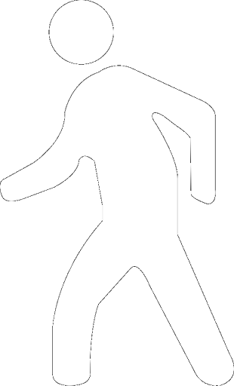


How do we assess vaccine efficacy?
Vaccine efficacy =
37.5% - 4.2%
37.5%
≈88.8%
vaccinated group experienced 88.8% fewer cases than they would have if they had not been vaccinated.
Not vaccinated
Risk = 9 ÷ 24 = 37.5%
Vaccinated
Risk = 1 ÷ 24 = 4.2%
More detail from CDC

Slide 16
CT Vaccine Requirements for Public School
Hep B | 3 doses, last dose on or after 24 weeks of age
Tdap/Td | 1 dose for students who have completed their primary DTaP series. Students who start the series at age 7 or older only need 3 doses of tetanus-diphtheria containing vaccine, one of which must be Tdap
Polio | At least 3 doses. The last dose must be given on or after 4th birthday
MMR | 2 doses separated by at least 28 days, 1st dose on or after 1st birthday
Varicella | 2 doses separated by at least 3 months-1 st dose on or after 1st birthday; or verification of disease. 28 days between doses is acceptable if the doses have already been administered.
Meningococcal | 1 dose
Notes:
Kaitlyn Slide
Full set at
https://tinyurl.com/CTimmunizations
https://portal.ct.gov/-/media/SDE/School-Nursing/Forms/Immunization_Requirements.pdf

Slide 17
ROUND
Open Discussion: Participants share their thoughts and respond to each other (12 min)
2
Under what conditions should a state government mandate vaccination?
Notes:
Kaitlyn
Under what conditions should a state government mandate vaccination?

Slide 18
ROUND
Work with your group to create a question that you would like us to answer. (4 min)
One person from your table will ask it.
The expert(s) will answer your questions in an open forum discussion.
3
COLLABORATIVE QUESTIONS

Slide 19
ROUND
The expert(s) will answer each group’s question and engage the entire room in a conversation about the topic. (10 min)
4
OPEN FORUM

Slide 20
ROUND
What did we learn?
5
TAKEAWAYS
About having conversations?
About the topics we discussed?
About ourselves?
About mathematics and/or how math might play a role in public life?
Notes:
*** have participants fill out a Google form for the takeaways section

Slide 21

THANKS!
Do you have any questions or comments?
Notes:
https://forms.gle/DiSr4tMLJWT1fJCv6

Slide 22
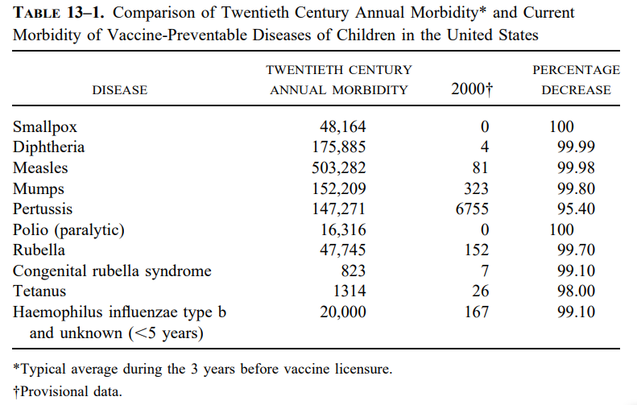
Extra Info - may be relevant during discussion
Notes:
From
Vaccination Mandates: The Public Health Imperative and Individual Rights
KEVIN M. MALONE AND ALAN R. HINMAN

Slide 23
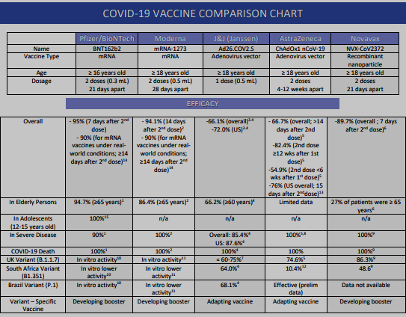
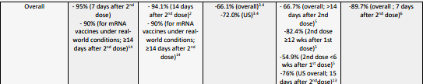
Extra Info - may be relevant during discussion

Slide 24
Extra Info - Efficacy (as of Oct. 2021)
Company | Efficacy | Authorized in U.S.
Pfizer | About 95% | ✅
Moderna | About 95% | ✅
Johnson and Johnson | 66% Globally /72% in U.S. | ✅
AstraZeneca - University of Oxford | about 70% | ❌
Russia’s Sputnik V Vaccine | 91.4% | ❌
Sinovac Biotech | 50.38% to 91.25% | ❌
Novavax | 90.4% | ❌
CanSino Biologics | 65.7% at preventing symptomatic cases; 90.98% efficacy in preventing severe disease. | ❌
Bharat Biotech | 100% against severe infection; 78% against mild, moderate and severe; 70% against asymptomatic | ❌
Notes:
https://www.biospace.com/article/comparing-covid-19-vaccines-pfizer-biontech-moderna-astrazeneca-oxford-j-and-j-russia-s-sputnik-v/

