Slide 1
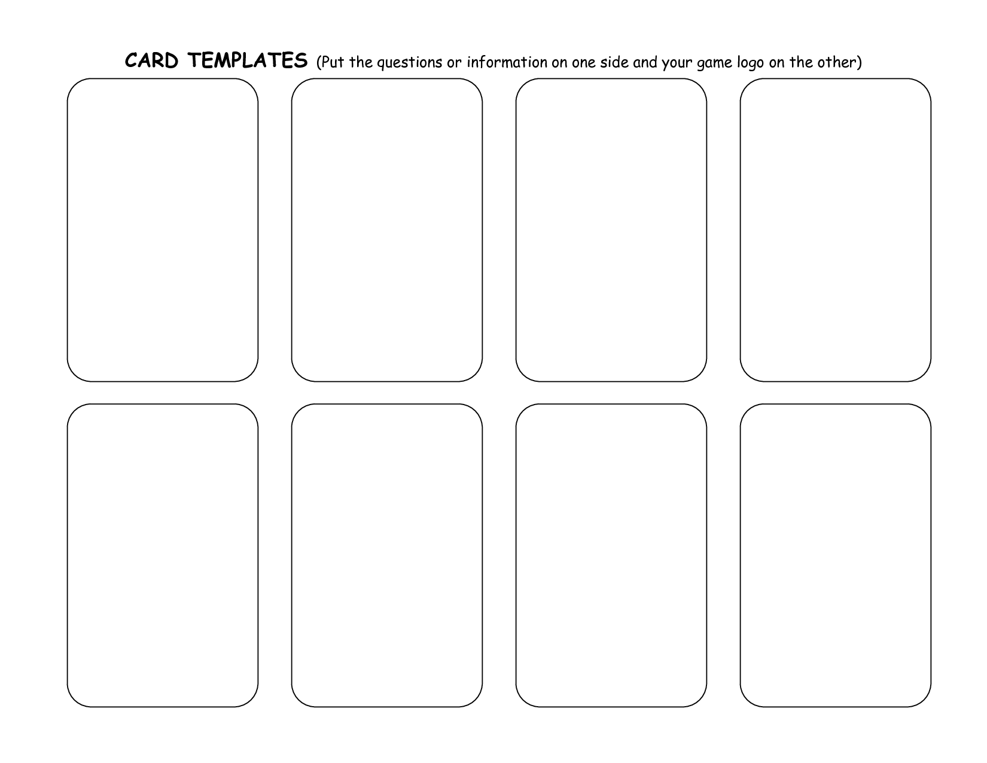
Low Income Student Count
464
Number of Teachers in District
108
Resident Student Count
1580
English Language Learners Count
49
Median Household Income
$56,807
A
A
A
A
A
Percentage of Students with a health disability
2.6%
Number of Schools in district
4
Percentage of families below poverty line
2.5%
Percentage of Parents/
Guardians not in labor force
16.2%
Minority Enrollment
31%
A
A
A
A
A
Notes:
Town A

Slide 2
Low Income Student Count
5050
Number of Teachers in District
522
Resident Student Count
8027
English Language Learners Count
1076
Median Household Income
$55,468
B
B
B
B
B
Minority Enrollment
85%
Percentage of Students with a health disability
8.3%
Number of Schools in district
12
Percentage of families below poverty line
18.7%
Percentage of Parents/
Guardians not in labor force
13.1%
B
B
B
B
B
Notes:
Town B

Slide 3
Low Income Student Count
1891
Number of Teachers in District
789
Resident Student Count
8588
English Language Learners Count
353
Median Household Income
$142,819
C
C
C
C
C
Percentage of Students with a health disability
3.3%
Number of Schools in district
15
Percentage of families below poverty line
7.6%
Percentage of Parents/
Guardians not in labor force
22.2%
Minority Enrollment
38%
C
C
C
C
C
Notes:
Town C

Slide 4
Low Income Student Count
577
Number of Teachers in District
159
Resident Student Count
1551
English Language Learners Count
108
Median Household Income
$76,360
D
D
D
D
D
Percentage of Students with a health disability
1.8%
Number of Schools in district
3
Percentage of families below poverty line
5.9%
Percentage of Parents/
Guardians not in labor force
6.7%
Minority Enrollment
19%
D
D
D
D
D
Notes:
Town D

Slide 5
Low Income Student Count
219,085
Number of Teachers in District
35,439
Resident Student Count
513,079
English Language Learners Count
42,474
Median Household Income
$78,444
CT
CT
CT
CT
CT
Percentage of Students with a disability
16.3%
Number of Schools in district
1506 in 205 districts
Percentage of families below poverty line
9.7%
Percentage of Parents/
Guardians not in labor force
7.5%
Minority Enrollment
50%
CT
CT
CT
CT
CT
Notes:
CT
Num Teachers - Ballotopedia
Num Schoos https://portal.ct.gov/-/media/SDE/Board/BoardMaterials030321/The_Condition_of_Education_in_Connecticut_2019_20.pdf

Slide 6
